Slide 1
My Experience at the Cyberdome: Lessons and Insights
Ashley Furr

Slide 2

Who Am I?
Hello, I’m Ashley!
Held customer service jobs my whole life, no previous IT experience
Started 2-year program at CWI
CWI gave me the knowledge and skills I needed to better myself
Cyberdome honed that knowledge and gave me confidence in those skills
Earned AAS in Cybersecurity in 2023
Started six-month internship at Cyberdome a week later
On route to gain CYSA+ through Cyberdome and CEH through CWI

Slide 3

What is the Cyberdome?
The Idaho Cyberdome is a cybersecurity initiative based in Idaho
We promote cyber awareness, education, and preparedness
We provide resources and training to individuals, organizations, and communities to enhance their understanding of cybersecurity threats and best practices, fostering a safer digital environment for all

Slide 4
Overview of the Cyberdome
WHAT EXACTLY DO WE DO?
WHO DO WE PROTECT AND WHY?
As the first line of defense, we monitor a SIEM (Security information and event management) called Stellar Cyber
Through the SIEM we conduct threat detection, incident response, and continuous monitoring of client environments
Cyberdome protects the network environments of rural Idaho
These include entire cities, school districts, local colleges, and counties
These networks need just as much protection as urban ones but lack the funding for full IT teams and local monitoring

Slide 5
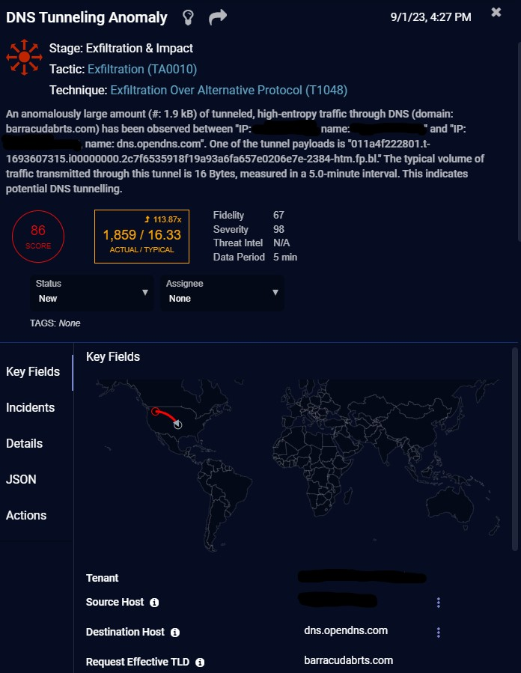
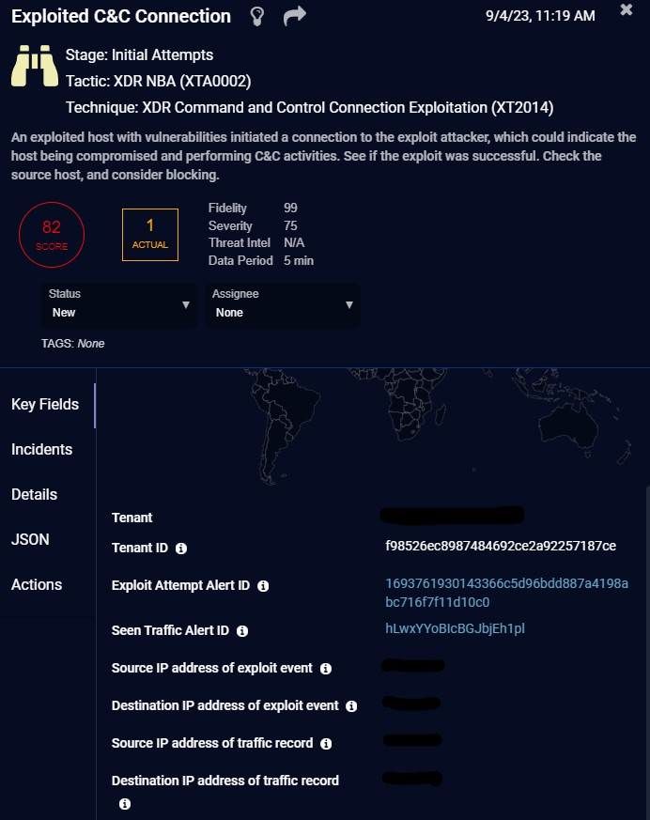
Cybersecurity in Action: Incident Response & SIEM
Actual Alerts
These alerts are generated by using a combination of behavioral analysis and threat signature detection in a Machine Learning (ML) environment
The ML detects anomalies using a networks baseline behavior (behavioral analysis) and if there is a deviation the SIEM gets an alert
The SIEM also uses threat signatures; essentially digital fingerprints or patterns that describe specific attributes or behaviors associated with known threats, malware, or attack techniques
Using both behavioral analysis and threat signature detection makes a SIEM that has more defense in depth and is highly adaptive to any network environment

Slide 6
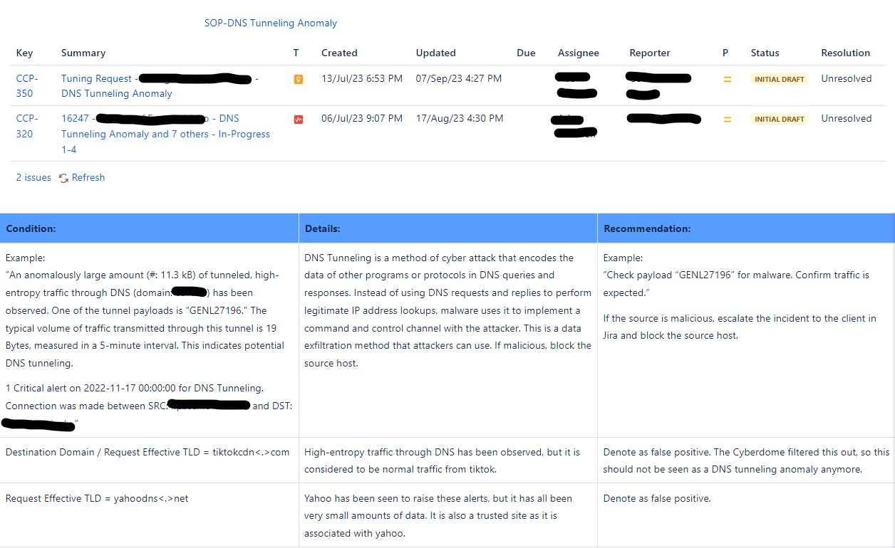
CONFLUENCE: RUNBOOK AND Cyberdome knowledge share
Confluence is where we have our:
Standard operating procedures for each incident type
Active/past tickets in Jira
Past incident examples to learn from
This is a great starting point for incident resolution
Anyone can edit and add to Confluence

Slide 7
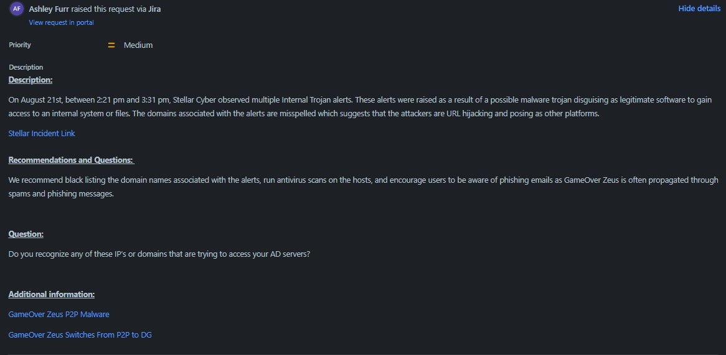
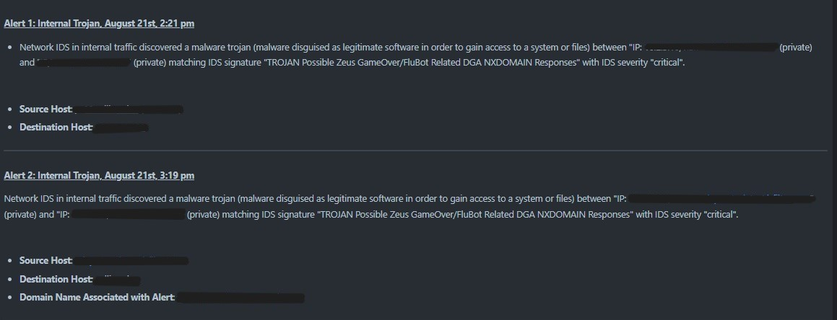
JIRA: TICKETING PLATFORM
Documentation is critical to this field
This is where we escalate incidents to the client and explain what incident has occurred on their network
We do this in a way that is:
Concise
Easy to read and understand
Has recommendations for what actions they should take
Has questions to learn more about their environment and specific needs
Its helpful to include links to the incident in question as well as any relevant information that may help the client understand the incident and how to prevent it going forward

Slide 8
Collaborate with your peers
Collaboration is one of the best things about the Cyberdome
Your fellow interns have a wealth of knowledge that you may not have, and you have knowledge that they may not have either
The interns are always happy to help each other to expand our skills and the strength of this field
The connections you make here can also help lead to job opportunities down the road as well as personal growth and friendships
The interns are constantly collaborating using:
Slack
Zoom Rooms
Email

Slide 9
What did I gain from THE Cyberdome?
I gained so much from my short time with the Cyberdome:
Job immediately after graduating in something I’m extremely passionate about
Knowledge and confidence in that knowledge
CYSA+ voucher and incredible training materials
Got real world knowledge of managing a high volume of alerts and distinguishing false positives from real threats
Learned how to navigate through complex and evolving attack techniques
Documentation skills
Complete freedom in my scheduling as well as freedom to work from home or in person
Resume and job-hunting advice
Made great connections with like minded people in the field of Cybersecurity

Slide 10
What does THE Cyberdome offer its interns?
$15 an hour starting wage
Invaluable skills and knowledge sharing
COMPTIA certification vouchers (SEC+, CYSA+, NET+ etc.)
The ability to start as a SOC intern or network engineer intern
Complete freedom in scheduling
Can be fully remote, in-person, or hybrid
A wonderful community of like-minded and helpful peers
19 hours a week, 4 hours of which is designated for studying
Real world experience in the field
The ability to help protect rural networks in Idaho

Slide 11
Conclusion
The Cyberdome is a great opportunity for anyone who is dedicated and passionate about cybersecurity and protecting others in rural networks of Idaho
Put in as much as you want to get out of this opportunity, there is much to be gained and it is worth the effort
Come join us over at the Dome! We would love to add you to our ever-expanding list of wonderful and knowledgeable Cyber Defense Analyst interns!

Slide 12
ANY Questions?

Slide 13
Thank you!

